Slide 1
Interpreter Project
COP 4020
Pete Dobbins

Slide 2
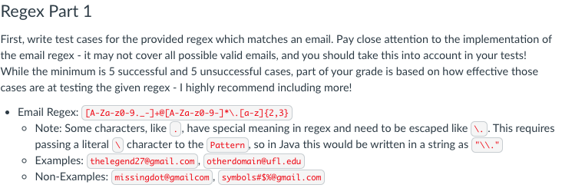
Regex Part 1
Using a Regex, specifies what valid and invalid emails will be.
valid
invalid

Slide 3
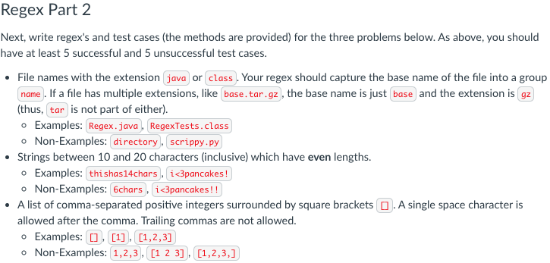
Regex Part 2
Describes what the Regex
you create should match.

Slide 4
Regex Part 2
valid

Slide 5
Regex Part 2
invalid

Slide 6
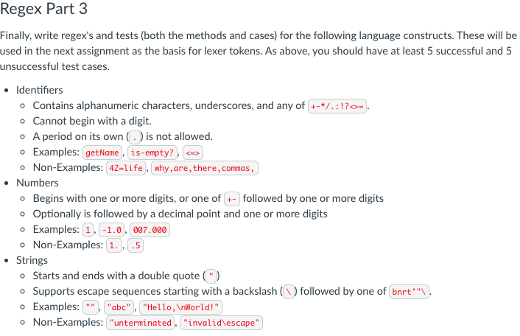
Regex Part 3
Token Types: IDENTIFIER, NUMBER, STRING, [and OPERATOR]
Lexemes

Slide 7
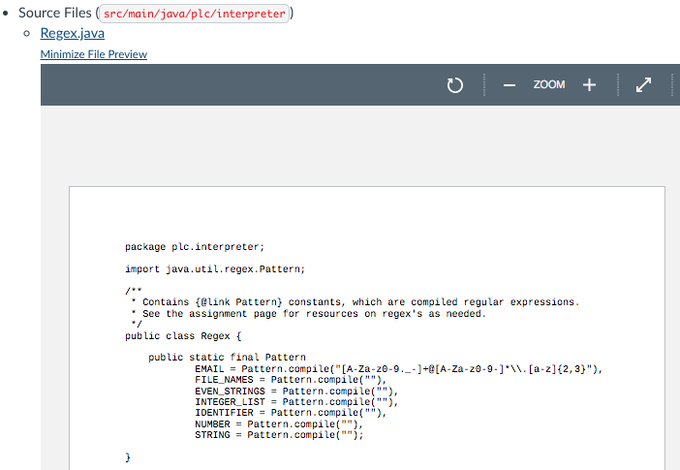
Regex.java
Regex Implementation

Slide 8
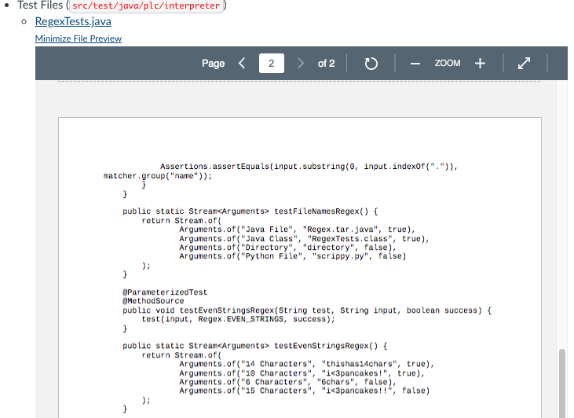
RegexTests.java
Valid
Test Cases

Slide 9
RegexTests.java
Invalid
Test Cases

